Slide 1


From data to hypothesis
Slim Fourati, Ph.D.
Assistant Prof. of Medicine
mailto: slim.fourati@northwestern.edu
@fouratilab and @fouslim
Notes:
Mean Si

Slide 2
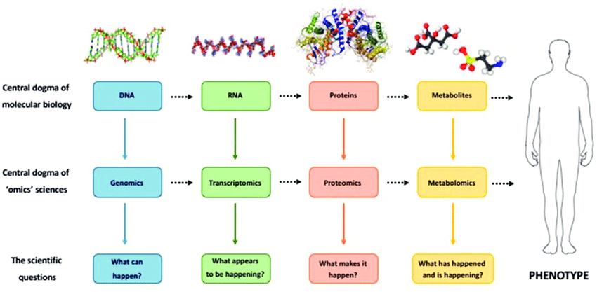
The Omes and the biological dogma
- The central dogma is inaccurate (not unidirectional relation)
- Knowing one Ome does not recapitulate other Omes

Slide 3
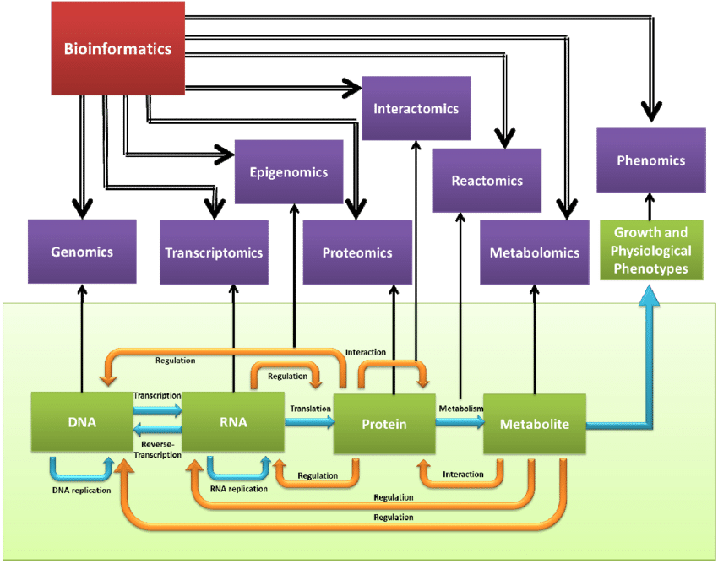
The Omes and the biological dogma revisited
REF: Li MW. et al. (2013) Int J Mol Sci Figure 1

Slide 4
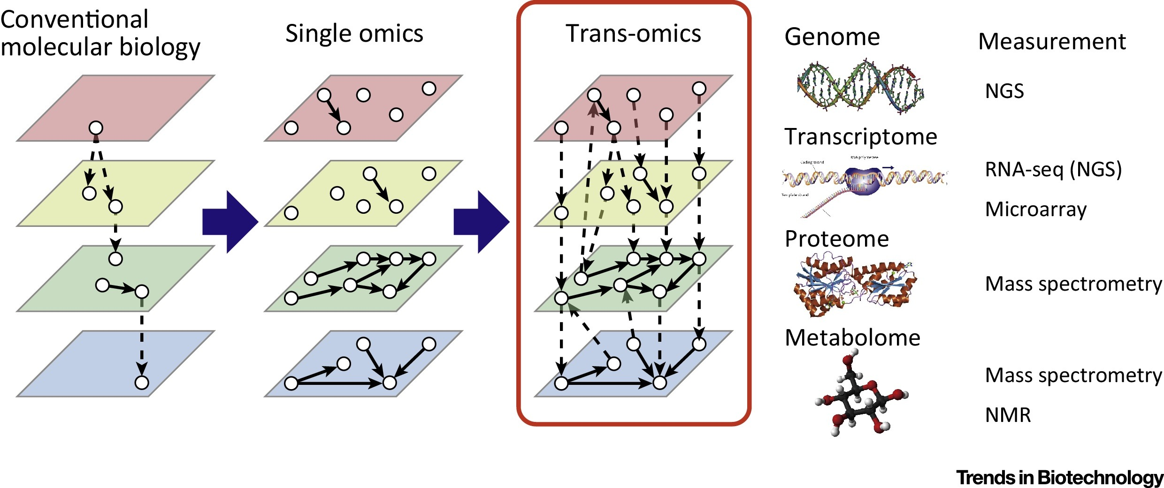
Why integrating Omics?
REF: Yugi K et al. (2016) Trends in Biotechnol. Figure 1

Slide 5
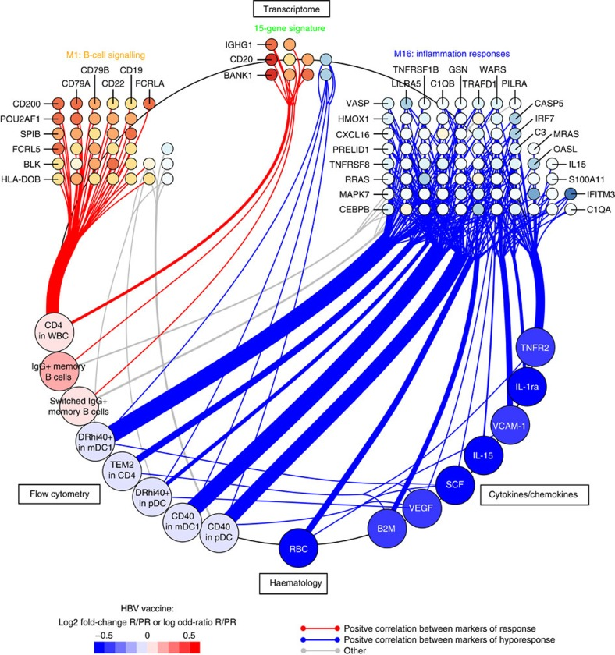
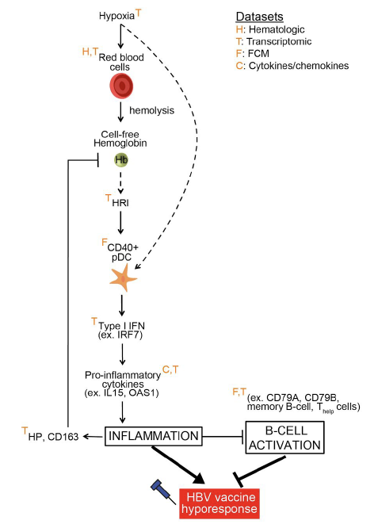
Why integrating Omics? (1)
REF: Yugi K et al. (2016) Trends in Biotechnol. Figure 1

Slide 6
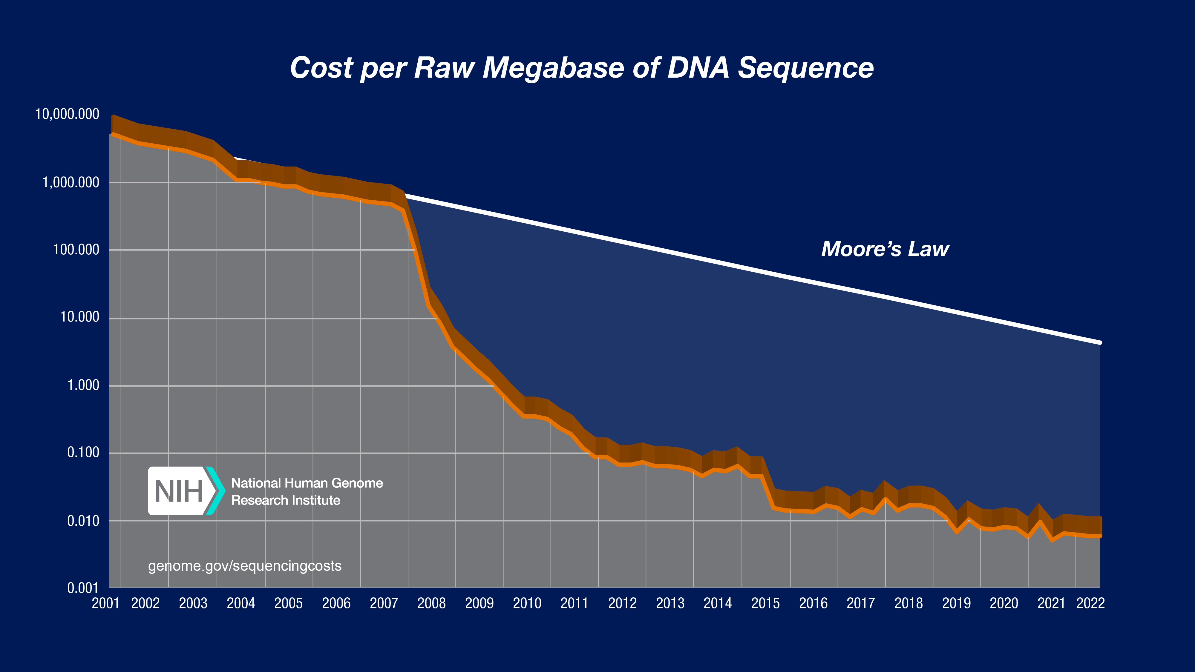
Why integrating Omics? (2)

Slide 7
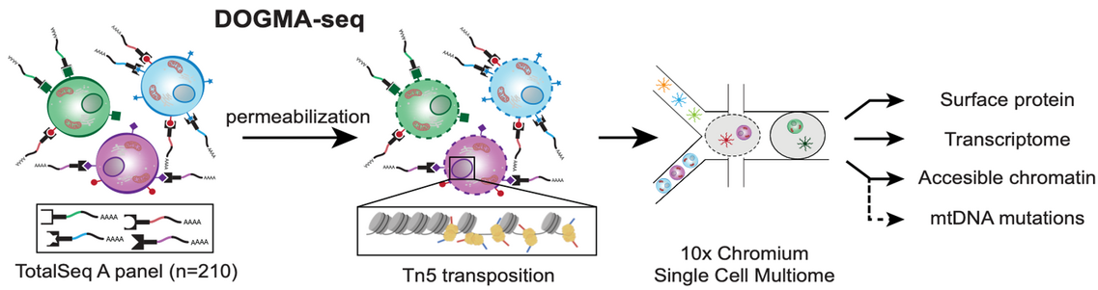
Why integrating Omics? (3)

Slide 8
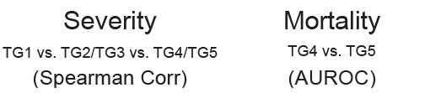
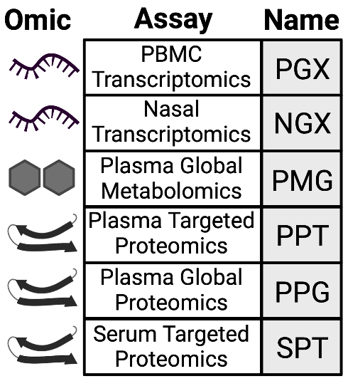
Why integrating Omics? (4)
DATA: IMPACC Test set
- Multi-omics classifier outperformed single-omic models
- Multi-omics classifier outperformed previously published markers of COVID-19 severity/mortality

Slide 9
Challenges in Omics data integration
- Data collected using different techniques (i.e. data modalities) generally exhibit heterogeneous statistical properties
Large amouts (and different patterns) of missing values
Undesired sources of heterogeneity
Overfitting
Complexity of the data requires unsupervised interpretable approaches

Slide 10
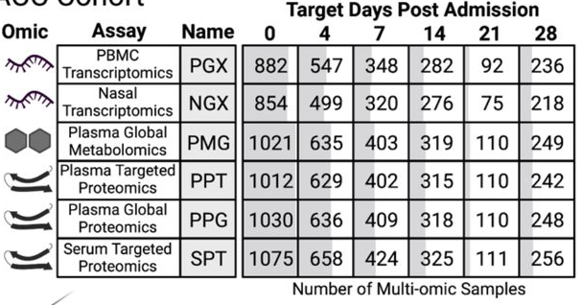
How to perform data integration? (paired samples)

Slide 11
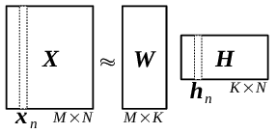
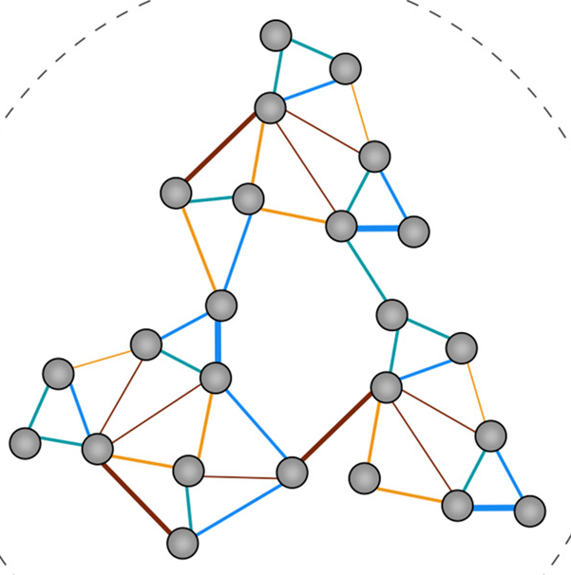
How to perform data integration? (data analysis)
Matrix factorization
Bayesian
Network-based
Correlation based

Slide 12
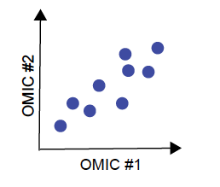
Correlation based
Correlation methods are based on the use of Pearson correlation or Spearman's nonparametric correlation (rank-based) to combine multiple sets of data measured on the same samples. These methods are the simplest used for multi-omics analyses. An example of how to implement a correlation method for integration of gene copy variation, DNA methylation, and transcription data is the CNAmet method.
However, these methods do not allow for the correction of
biases related to the technologies used to generate this data.

Slide 13
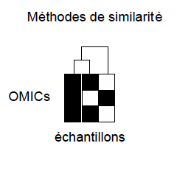
Similarity based
Similarity methods are primarily used for the identification of subgroups
samples based on multiomics data. Two individuals are grouped together in a
same subgroup, if individuals are grouped together when each data type
is partitioned separately and using different partitioning methods (e.g.
hierarchical, agglomerative partitioning).
An implementation of a similarity method
for the integration of gene copy variation data, nucleotide polymorphisms
and transcription is the PINSplus method.

Slide 14
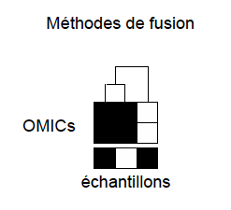
Fusion based method
Fusion methods are primarily used for the identification of subgroups
samples based on multiomics data. Similar to similarity methods,
Fusion methods combine elements (e.g., RNA and protein expression) from a sample
only if the individual is partitioned into the same subgroup for different types of
data.
An implementation of a similarity method for the integration of
variation of gene copies, nucleotide polymorphisms, and transcription is the
PFA method (147).

Slide 15
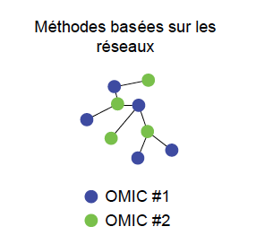
Network-based
Methods based on existing networks of interactions between genes, RNA, proteins to
combine different datasets. Algorithms for traversing the network are
used to connect different elements per sample (e.g., Floyd's algorithm to identify
the shortest paths between all node pairs).
An implementation of a
a network-based method for integrating gene copy variation data,
of nucleotide polymorphisms and transcription is the NetICS method (145).
Limitations
of these methods include the fact that they are based on the establishment of interaction networks at the
and attempt to identify interactions between genes, RNAs, proteins involving
nodes with strong connectivity.

Slide 16
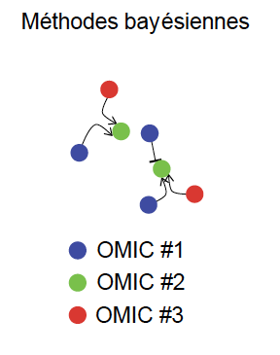
Bayesian
Bayesian methods also make use of networks of interactions between genes.
RNA, proteins to combine different datasets. These methods use the theorem
to determine the activity of a gene in the network, where the probability of activation of a
gene is described mathematically as the product of the probabilities of induction of the number of
DNA copies, RNA level, and protein level.
An example of an implementation of this
The method is PARADIGM (146). These methods are also limited by the quality of the networks
and attempt to identify nodes with strong connectivity.

Slide 17
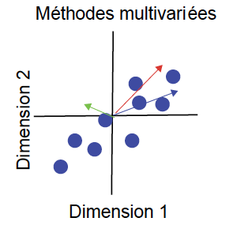
Matrix factorization
Multivariate methods rely on data dimension reduction techniques.
This is because once the dimensionality of different types of data is reduced (e.g. using the
PCA technique where each dimension corresponds to the linear combination of the elements)
Dimensions can be combined across data types. An implementation of this type
is available in the mixOmics app

Slide 18
What is the expected result of data integration?
Depends on the biological question:
An overview of the role of each ‘omics in a biological system
A better understanding of the relationship (correlation)
between the ’omics types
A correlated / co-expressed molecular signature leading to
more insight into molecular mechanisms
A predictive analytical model towards personalised medicine
All of the above (?)

Slide 19
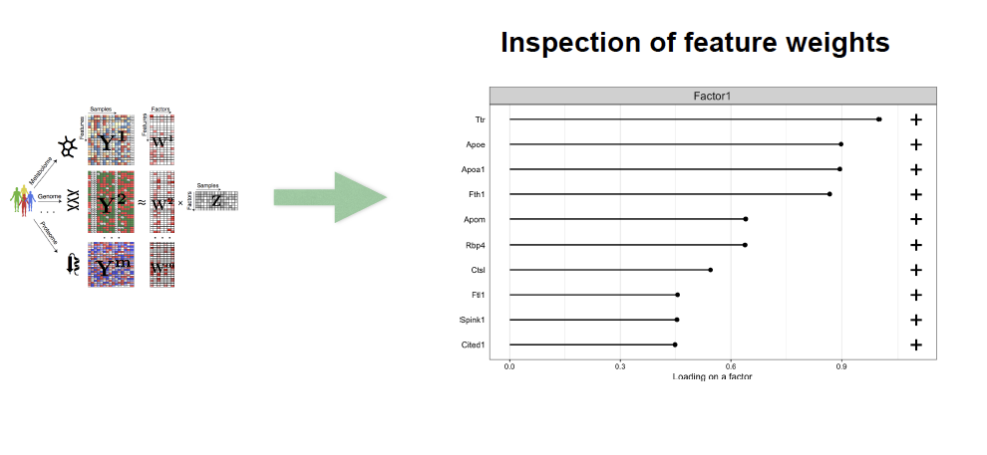
Downstream analysis (feature importance)

Slide 20
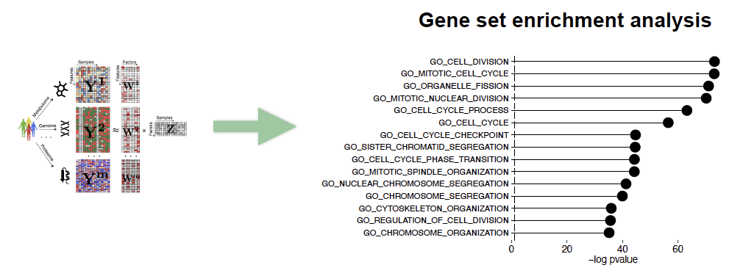
Downstream analysis (pathway analysis)

Slide 21
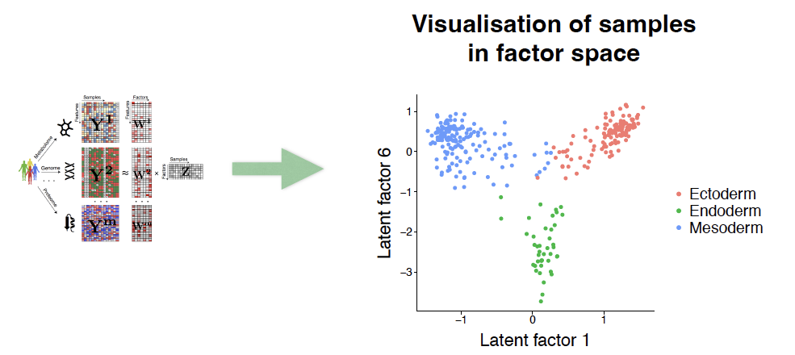
Downstream analysis (clustering)

Slide 22
Practical exercise: HepB vaccine
Aging is associated with a weaker response to vaccination; The mechanism in question
is fuzzy. In this study, adults over 65 years of age, naïve to the hepatitis B virus,
received three vaccines, including one for hepatitis B.

Slide 23
Practical exercise: The cohort
One-hundred and seventy-four healthy adults received vaccines
against Hepatitis A (HAV)/HBVs, Diphtheria/Tetanus toxoids
and Cholera bacteria/toxin

Slide 24
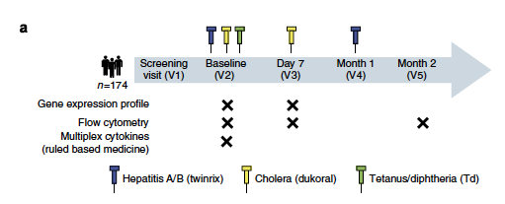
Practical exercise: The Omics

Slide 25
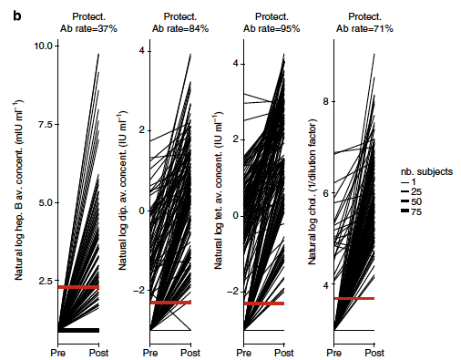
Practical exercise: The endpoint

Slide 26
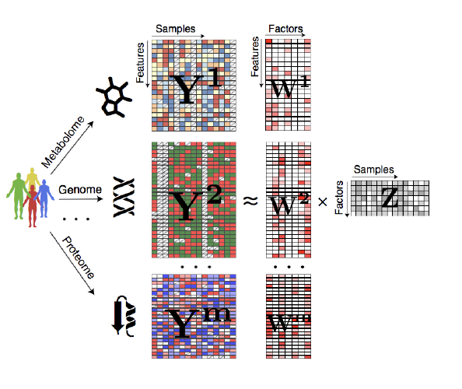
MOFA
The structure of the data is specified in the prior distributions of the Bayesian model
The critical part of the model is the use sparsity priors, which enable automatic relevance determination of the factors

